Slide 1

columnar analysis - I
School of Physics

Slide 2
Agenda
Notes:
To get introduced to Uproot and Awkward array

Slide 3
Agenda:
To understand the tools needed for columnar analysis in HEP.
Review data structures used in HEP and current analysis paradigms.
To realize the need for a new way to handle data from HEP.
Get introduced to libraries like Uproot and Awkward array.

Slide 4
Some general comments
Notes:
How does a code run: scripting, interpretation and compilation
A few comments about the different programming languages and where does python stand
a few important features of python: Various checks, environments and dynamic typing
a short introduction to numpy

Slide 5
The ABCs of “running” a code in python
Python is an interpreted language
Source Code
E.g. print(“Hello World”)
Interpreter
Performs various checks
Byte Code
Python Virtual Machine
Executes the byte code
Console Output Hello World

Slide 6
The ABCs of “running” a code in python
Python is dynamically typed
>>> x = 0
>>> type(x)
<class 'int'>
>>> y = 0.2
>>> type(y)
<class 'float'>
>>> z = x+y
>>> type(z)
<class 'float'>
>>> k = "Python"
>>> type(k)
<class 'str'>

Slide 7
The ABCs of “running” a code in C++
C++ is a compiled language
Source Code
E.g. std::cout<<“Hello World”;
Preprocessing
Unpacks packages that were used
Compiler
Converts to Assembly code
Assembler
Converts to Machine code
Machine Code is executed
Console Output Hello World

Slide 8
The ABCs of “running” a code in C++
C++ is statically typed
Test.C:
#include<iostream>
int main(){
x = 2;
std::cout<<x<<std::endl;
}
Output:
test.C: In function ‘int main()’:
test.C:3:2: error: ‘x’ was not declared in this scope
3 | x = 2;
| ^

Slide 9
The ABCs of “running” a code in C++
C++ is statically typed
Test.C:
#include<iostream>
int main(){
float x = 2;
std::cout<<x<<std::endl;
}
Output:
2.0

Slide 10
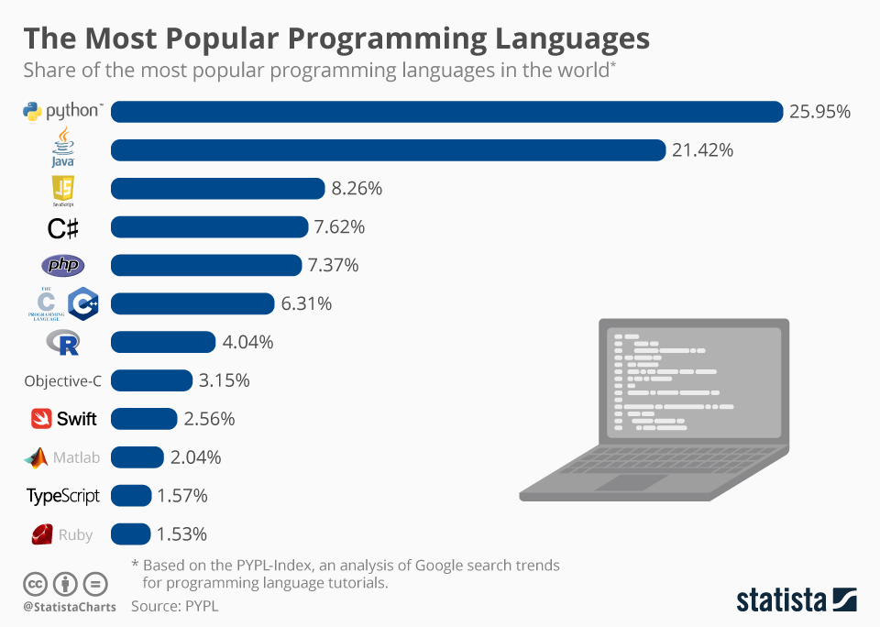
Why should we use python?
Python continues to be the fastest growing language in the world.
Python has a high-level syntax which is easy to learn.
Python has extensive community support with thousands of libraries and modules.
Strong support for machine leaning applications.
Good implementation for parallel computing and big data scenarios.
2019 data

Slide 11












Why should we use python?: Libraries

Slide 12
Numpy
Numpy is short for Numerical Python.
It provides support to handle multidimensional array formated data and process such data fast.
Numpy also has a lot of functions needed for scientific computing.
>>> import numpy as np
>>> a = np.array([[1,2,3],[4,5,6],[7,8,9]])
>>> a
array([[1, 2, 3],
[4, 5, 6],
[7, 8, 9]])
>>> b = np.arange(1,10).reshape((3,3))
>>> b
array([[1, 2, 3],
[4, 5, 6],
[7, 8, 9]])
>>> c = np.arange(10)
>>> c
array([0, 1, 2, 3, 4, 5, 6, 7, 8, 9])
>>> np.sqrt(c)
array([0. , 1. , 1.41421356, 1.73205081, 2. ,2.23606798, 2.44948974, 2.64575131, 2.82842712, 3.])

Slide 13
Data in HEP (especially from CERN)
Notes:
The nature of data structure in HEP
The jaggedness situation and Numpy
The way root files are stored and accessed

Slide 14
Let’s look inside a root file
prayag@PureBook-S14:~/Coffea/data$ ls
ZZTo4e.root
prayag@PureBook-S14:~/Coffea/data$ root –l ZZTo4e.root
>>> root [0]
Attaching file ZZTo4e.root as _file0...
(TFile *) 0x55a01b484850
>>> root [1] .ls
TFile** ZZTo4e.root
TFile* ZZTo4e.root
KEY: TTree Events;1 Events

Slide 15

Let’s look inside a root file
>>> root [2] Events->Print()
******************************************************************************
*Tree :Events : Events *
*Entries : 1499093 : Total = 324940562 bytes File Size = 161655422 *
* : : Tree compression factor = 2.01 *
******************************************************************************
*Br 0 :run : run/I *
*Entries : 1499093 : Total Size= 5998601 bytes File Size = 31892 *
*Baskets : 21 : Basket Size= 485888 bytes Compression= 188.07 *
*............................................................................*
*Br 1 :luminosityBlock : luminosityBlock/i *
*Entries : 1499093 : Total Size= 5998901 bytes File Size = 57934 *
*Baskets : 21 : Basket Size= 485888 bytes Compression= 103.53 *
*............................................................................*
… … … …
… … … …
… … … …
What’s going on?
[ Answer in upcoming slides ]

Slide 16
The Anatomy of .root files and TTree
Example.root
Root files are made specifically for data compression and to handle objects called TTree .
A tree may contain several Branches.
A Branch usually contains a long list of events(Record type row wise).
Each event has a constant list of variables(leaves) stored in their individual columns.
Each variable contains a data type ,for e.g., 1D array.(Basket)
These 1D array usually have variable lengths.
TTree
Other objects
Branch 0
Branch 1
Branch 2
Muon_E
Event 1 : [123.2 44.5]
Event 2 : []
Event 3 :[12.2 0.6 55.0 34.9]
Event 4 :[91.2]
.
.
.

Slide 17
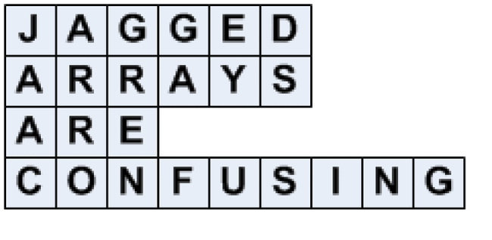
Jaggedness and Compression
Columnar structure with offset array for event reference
Muon_E
123.2
44.5
12.2
0.6
55.0
34.9
91.2
.
.
.
Offset
0
0
2
2
2
2
3
.
.
.
Jagged Structure
Muon_E
Event 1 : [123.2 44.5]
Event 2 : []
Event 3 :[12.2 0.6 55.0 34.9]
Event 4 :[91.2]
.
.
.

Slide 18
Compression in the root files: Demystified
Same offset for many variables
Offset
0
0
2
2
2
2
3
.
.
.
Muon_E
123.2
44.5
12.2
0.6
55.0
34.9
91.2
.
.
.
Muon_eta
123.2
44.5
12.2
0.6
55.0
34.9
91.2
.
.
.
Muon_phi
123.2 …
44.5 …
12.2 …
0.6 …
55.0 …
34.9 …
91.2 …
. .
. .
. .
Each column is a list and has the same data type for all elements.
Saving one single list is cheaper than storing a million lists.
This type of transformation produces highly optimized compression.

Slide 19
The problem with Numpy and other current tools
Numpy can’t handle jagged arrays. Numpy can handle rectangular arrays only.
Using a different numpy array for each event leads to huge computational penalty.
Pandas too can’t handle jagged arrays.
When using C++ we expand the compressed root file on RAM and use for loops which might not give us the best efficiency.
Muon_E
Event 1 : [123.2 44.5] create ndarray
Event 2 : [] create ndarray
Event 3 :[12.2 0.6 55.0 34.9] create ndarray
Event 4 :[91.2] create ndrray
. Have to create millions
of arrays!
.

Slide 20

A short speed test
School of Physics
CMSLab
Notes:
C++
Pyroot
RDataframe
Python loops
Numpy
Loops and Numpy
Numba

Slide 21
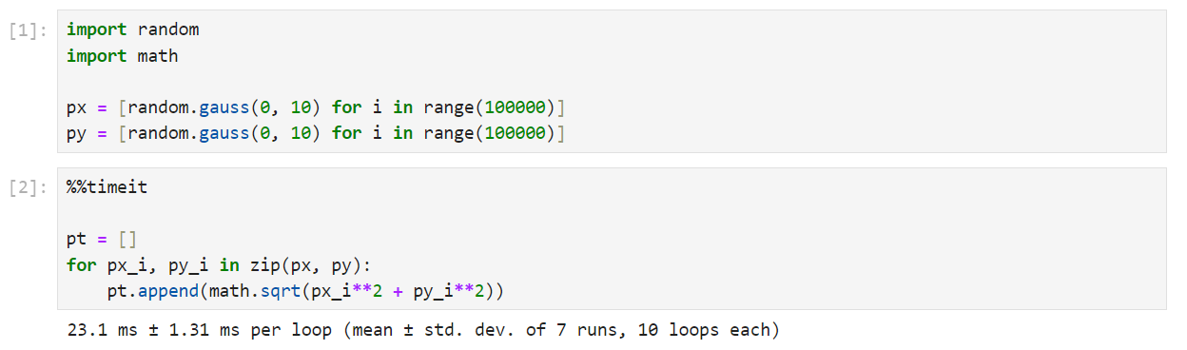
Good old for-loops

Slide 22
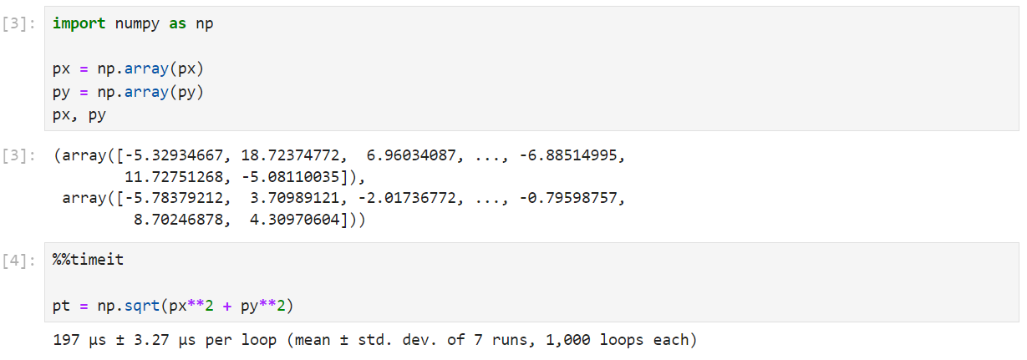
Numpy

Slide 23
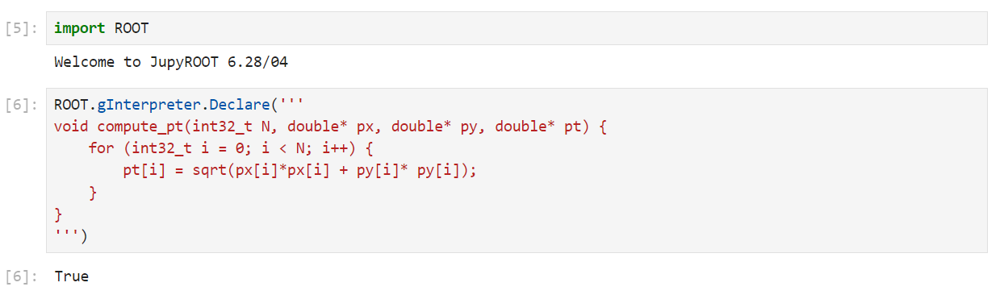
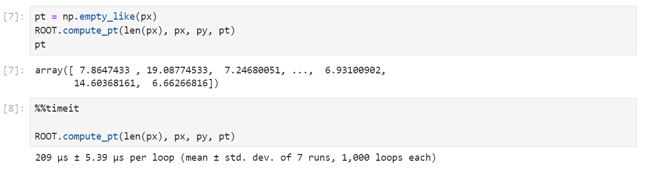
pyROOT
Just-In-Time ( JIT )
compilation

Slide 24

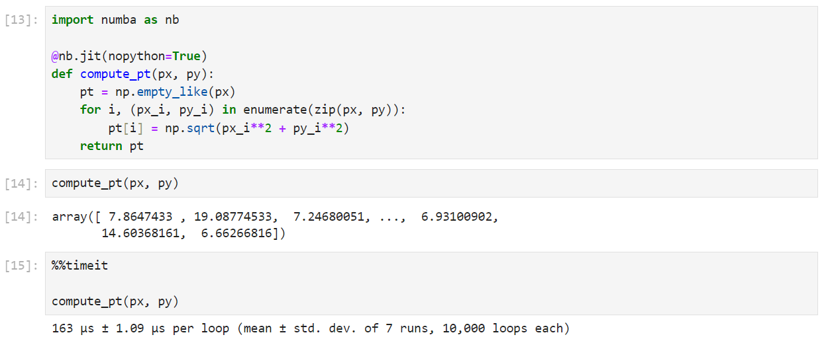
Numba
Just-In-Time ( JIT )
compilation

Slide 25
Summarizing our needs
Notes:
Need a framework to handle root files in python without the need to install root
Need a framework to handle jaggedness in arrays
framework should be intuitive to implement .i.e. should have easily understandable code
framework should allow a good computational advantage over the already existing tools

Slide 26
Summarizing our needs
Need a framework to handle root files in python without the need to install root
Need a framework to handle jaggedness in arrays
framework should be intuitive to implement .i.e. should have easily understandable code
framework should allow a good computational advantage over the already existing tools

Slide 27
Uproot and Awkward Array
Notes:
Brief explanation of what uproot does
Brief explanation of what awkward array does
The friendship between Uproot and Awkward Array #jaiandveeru

Slide 28
Uproot and Awkward Array
Uproot is a I/O library which facilitates reading and writing of root files without the need to install root C++.
Awkward array is a tool specifically designed to handle variable sized nested arrays, as is common in HEP.

Slide 29

Uproot and Awkward Array
Awkward array and Uproot work together to fix all our previous problems.
Awkward array understands numpy-like idioms. Hence, we should have no problems provided we already know how to use numpy.
Awkward Array
Uproot
Fig: Jai and Veeru

Slide 30
Uproot
Notes:
Show from jupyter notebook

Slide 31
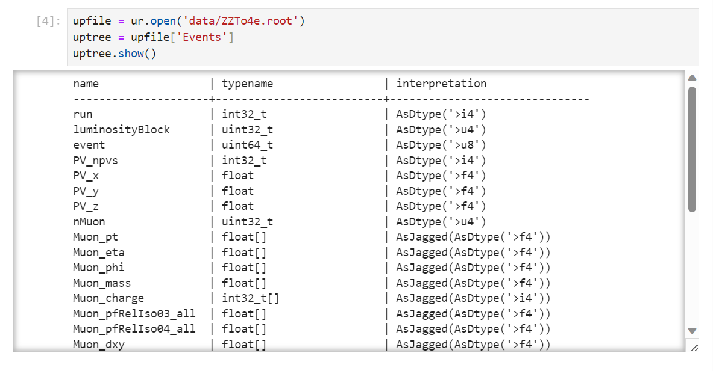
A brief demonstration of uproot
import uproot as ur
Jagged array with 4bit float elements

Slide 32
A brief demonstration of uproot
elec = uptree.arrays(
[ 'nElectron', 'Electron_pt', 'Electron_eta', 'Electron_phi’, 'Electron_charge' ],
cut="nElectron >= 2",
how="zip",
entry_stop=1000000
)
An Awkward Array
<Array [{nElectron: 3, Electron: [, ... ] type='638197 * {"nElectron": uint32, "...'>

Slide 33
A brief demonstration of uproot
Info about the first event
elec[0]
<Record ... phi: 1.15, charge: 1}]} type='{"nElectron": uint32, "Electron": var ...'>
elec[0]["Electron"]
<Array [{pt: 11.9, eta: 0.335, ... charge: 1}] type='3 * {"pt": float32, "eta": ...'>
elec[0]["Electron"].fields
['pt', 'eta', 'phi', 'charge']
elec[0]["Electron"]["pt"]
<Array [11.9, 26.7, 40.2] type='3 * float32'>

Slide 34
Awkward Array
Notes:
Show from jupyter notebook

Slide 35
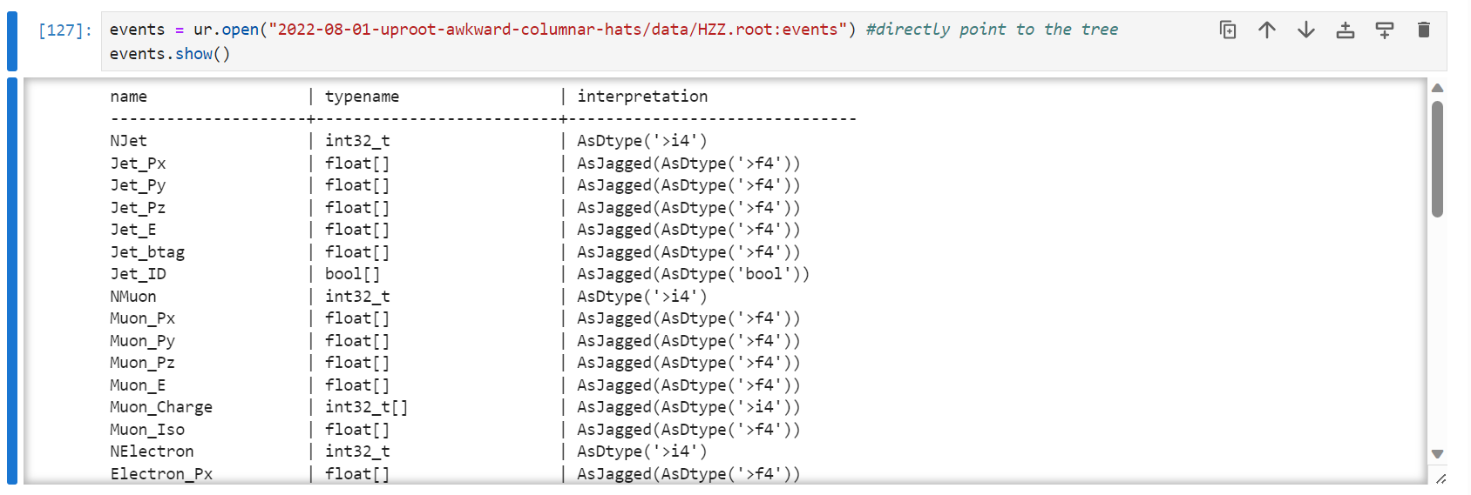
A brief demonstration of awkward array

Slide 36
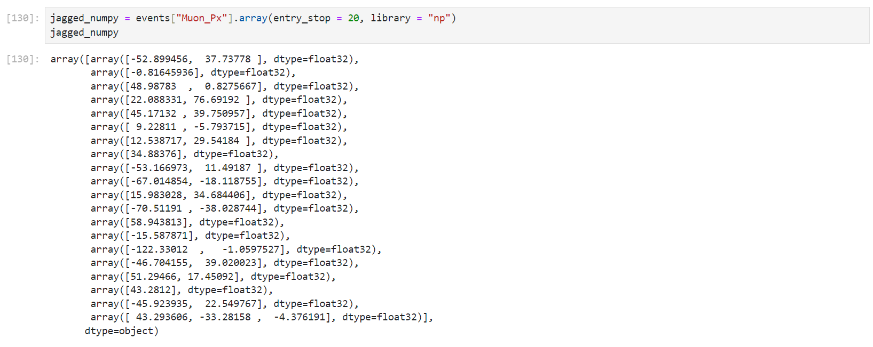
A brief demonstration of awkward array
Numpy’s equivalent is cumbersome and inefficient:

Slide 37
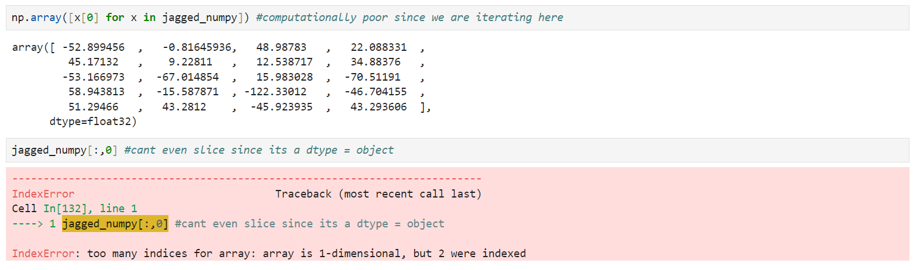
A brief demonstration of awkward array
What if I want the first item in each list as an array?
That’s where awkward helps us

Slide 38
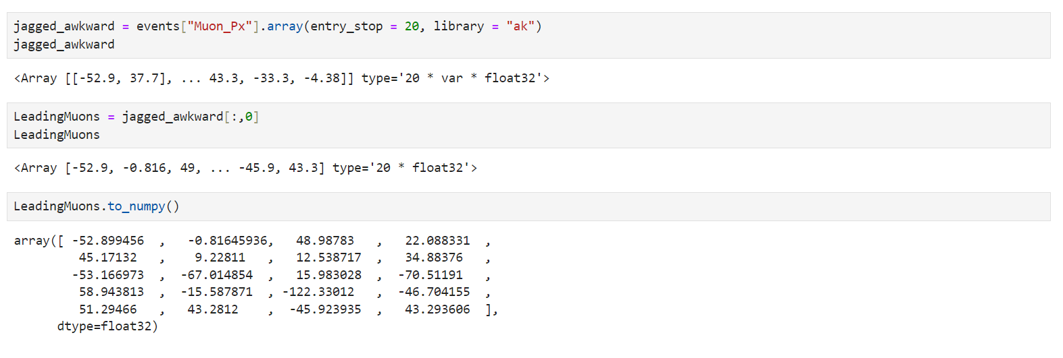
A brief demonstration of awkward array

Slide 39
A brief demonstration of awkward array
Why is awkward array more efficient?
Slicing through data is more computationally inexpensive than modifying any large buffers over and over again.
Can use numpy-like idioms on json-like data structure(dictionary/hash-map)
Numpy-like functional broadcasting operations(ufuncs) are valid in awkward array

Slide 40
And they have many more features….
To learn more about the uproot and awkward array, please find the link my jupyter notebook : ColumnarHEP
To get a deeper understanding of the concepts involved, follow the LPC HATS on Uproot and Awkward array.

Slide 41



Thank you for listening!

